Slide 1
Webpage Understanding: an Integrated Approach
Jun Zhu, Zaiqing Nie, Ji-Rong Wen, Bo Zhang, and Hsiao-Wuen Hon
Jun Zhu
Dept. of Comp. Sci. & Tech., Tsinghua University

Slide 2
Outline
Motivating Examples
Windows Live Product Search
Libra Academic Search
Integrated webpage understanding model
Statistical structure mining model
Integrated structure mining and text processing model
Experiments
Conclusions
Notes:
Here the contents of this talk. I will start with a real-world application of Windows Live Product Search to introduce the idea of Web object extraction. And I also discuss the existing decoupled record detection and attribute labeling methods and show their disadvantages.
Then I will talk about our proposed simultaneous record detection and attribute labeling.
I will also show some experiments.

Slide 3
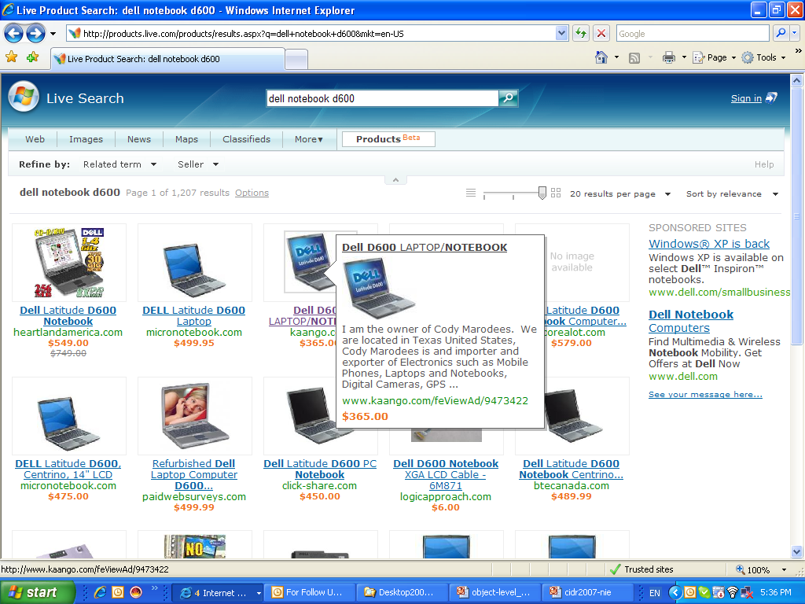
Motivating Examples
Windows Live Product Search (http://products.live.com)
A single extractor for all product webpages
Template-Independent
Libra Academic Search (http://libra.msra.cn)
Extraction of web objects like Authors, Papers and Conferences is one key technique
More examples: CiteSeer, Google Scholar, Rexa…
Notes:
Web data extraction is an information extraction (IE) task that identifies information of interest from webpages. For example, in David’s homepage we can find his name, title, affiliation, and published papers. Another example is the product information on the web for sale. Identify this information is apparently of great significance for data mining and information retrieval. However, several characteristics make this task challenging.
On webpages, the data have more structures but less grammars. For example, the data have 2D spatial information like size and position. The text contents are always text fragments and are lack of natural language processing grammars. Also, the large-scale and heterogeneous webpages require that the methods must be scalable enough and easily adapted. Template-dependent methods cannot be applied because they heavily rely on the design patterns or templates.
Existing work on template-independent methods include the partial tree alignment algorithm of Zhai in 2005. And our work in ICML 05, KDD’06 and KDD’07. Let’s talk a little more about these methods.

Slide 4
Characteristics of Webpage
Huge number, Heterogeneous
Some structures
Hierarchical HTML tag tree
Visually two-dimensional layout
Related information clusters
Special formats (like table, list, and etc.)
Lack of grammars
Many text contents are fragments
Lack of the natural language grammars
Attribute missing
Notes:
Before going ahead, let’s see what characteristics of the webpages make the problem non-trival.
First, the number is huge, and the data are heterogeneous. So, it’s not easy to develop a general model.
Second, the data on the web do have some structures: for example,

Slide 5
Tasks of Web Data Extraction
Structure Mining:
Data Record Detection
Group the related information about the same object together, and distinguish unrelated information
Informative Block Detection
An informative block can contains interested information about several objects
Data Field Extraction
Identify HTML elements as attribute values
Text content processing
Identify purified target information
Go into HTML elements: Tokens are atomic units
Author
Author
Author
Authors
Notes:
Generally, web data extraciton can be grouped as two types.
The first is structure mining. Typical tasks include data record detection, informative block detection, and data fields extraction.
Data record detection is to group the related information about the same object together. For example, this is a paper record.
Informative block detection is like record detection. An informative block can contains several data records and other interested information.
Data field extraction is performed at the HTML element level. It identifies the element values.
The second type of web data extraction is text content processing.
In structure mining, HTML elements are atomic extraction units, however, on webpages, an HTML element can contains multiple attributes. E.g. this element contains three authors. Text processing is to identify each author name.

Slide 6
In current, there is no integrated structure mining and text content processing model

Slide 7
Existing Attempts – De-coupled Approaches
Learning to Extract Text-based Information from the World Wide Web. KDD’97
Heuristic-based pre-processing
Use page layout cues to parse web pages into logically coherent segments
NLP flat text extraction
CRYSTAL NLP system
Using HTML Formatting to Aid in Natural Language Processing on the World Wide Web. CMU Senior Honors Thesis’98
Heuristic-based pre-processing
Construct a struct tree for an input web page
Extraction rules are coded based on the tree representation
Notes:
To adopt NLP systems to process texts on Web, traditional methods use some pre-processing to parse Web data. Here are two examples……

Slide 8
Disadvantages
Pre-processing is non-trivial because of the diversity of web pages and various domains
De-coupled approach is ineffective [Zhu et al., 2006]
Not convincing that parsed text fragments have the grammars as required in NLP systems
Typical NLP methods ignore structure formats

Slide 9
Why no integrated approach?
Much work on page layout and format analysis, but little work on text content processing
Wrapper-based methods are difficult to scale
Typical natural language processing methods are not directly applicable
Fragmental web text contents are lack of grammars
Structure mining methods are mainly rule-based while NLP methods are statistical
Not easy to merge!

Slide 10
Outline
Motivations
Windows Live Product Search
Libra
Integrated webpage understanding model
Statistical structure mining model
Integrated structure mining and text processing model
Experiments
Conclusions
Notes:
Here the contents of this talk. I will start with a real-world application of Windows Live Product Search to introduce the idea of Web object extraction. And I also discuss the existing decoupled record detection and attribute labeling methods and show their disadvantages.
Then I will talk about our proposed simultaneous record detection and attribute labeling.
I will also show some experiments.

Slide 11
Statistical Web Structure Mining Model (KDD 2006)
Joint Optimization of Record Detection and Labeling of HTML Elements
Mutual Enhancement
Vision-based Page Representation
Vision-Tree
Hierarchically segment a webpage according to its Visual Layout
Consider both Record Detection and Attribute Labeling as labeling tasks on the vision-tree
Hierarchical Conditional Random Fields (HCRFs)
Fixed model structure
Junction tree algorithm for parameter estimation and labeling
Notes:
The de-coupled methods are far from perfect. For example, the error propagation. Lack of semantics in record detection. Lack of mutual interactions in attribute labeling. Local Markov assumption.
To address these problems, we propose the hierarchical model. The model is just an instance of our proposed Dynamic Hierarchical Markov Random Fields.
In this model, we can jointly do Web object extraction and overcome all the above limitations. Of course, this model suffers from the blocky artifact issue. Actually this is the main motivation we propose the dynamic model.
About this model and also the application, more details can be found in our KDD 2006 paper.

Slide 12
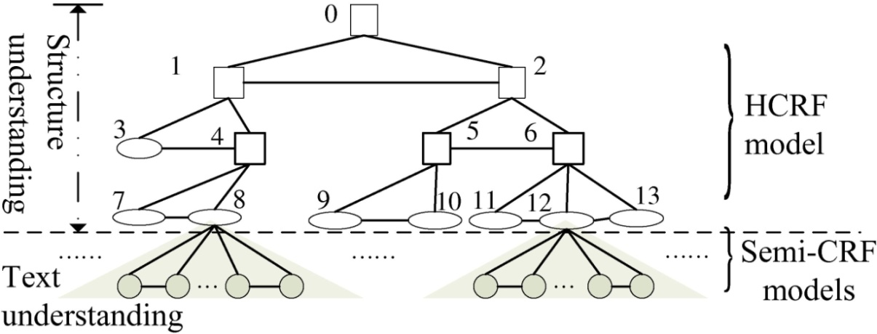
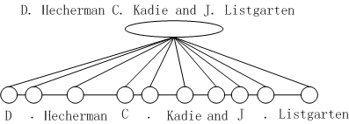
Integrated Webpage Understanding Model
Basic Idea
For structure mining, we use a full hierarchical CRF
For text processing, we use semi-Markov Random Field models
Integrated Model
Let leaf nodes act as the bridge between two types of models

Slide 13
Factorized Distribution
Definitions
Variables in HCRFs:
Segmentation of leaf nodes:
Segment:
Segmentation:
Vector of segmentation:
A valid assignment:
Factorized distribution:

Slide 14
Separate Learning
The integrated model can be separately learned by MLE
Each model has its learning method
Setup separate training datasets

Slide 15
Outline
Motivations
Windows Live Product Search
Libra
Integrated webpage understanding model
Statistical structure mining model
Integrated structure mining and text processing model
Experiments
Conclusions
Notes:
Here the contents of this talk. I will start with a real-world application of Windows Live Product Search to introduce the idea of Web object extraction. And I also discuss the existing decoupled record detection and attribute labeling methods and show their disadvantages.
Then I will talk about our proposed simultaneous record detection and attribute labeling.
I will also show some experiments.

Slide 16
Experiments
A New real-world dataset
Job corpus, Address and Paper Corpora contains only text documents and no HTML structures
We build a new real-world dataset on researchers’ homepages
Researchers’ homepages contain both structure patterns and large amount of text contents needing to be processed
292 homepages are randomly downloaded from the computer science departments of about 10 universities, like CMU, MIT, UC Berkeley and Stanford; also from research labs, like MSR, IBM Research, AT&T Bell lab.
13 attributes are identified:
Methods evaluated
De-coupled sequential method
HCRFs for structure mining, and Semi-CRFs for text segmentation and labeling
Integrated method with/without NLP-Chunking features
Evaluation Metrics
Precision, Recall, F1 on each attribute
Notes:
Here are the setup of our experiments

Slide 17
Extraction Accuracy
Integrated webpage understanding model performs better on most of the attributes
De-coupled baseline achieves higher recalls on Title, Affiliation, Street , Region, and Zip code but lower precisions due to its failure to consider global spatial information

Slide 18
NP-Chunking Features
NP-chunking helps Author significantly, while causes slight decreases on Name, Title and Affiliation
Notes:
We use NP-chunking results to introduce additional features.

Slide 19
Conclusions & Future Work
Webpage understanding should consider both structure and text contents
Structure mining can help text processing in the integrated extraction model
NLP features can help in the integrated model
Future Work
Study more NLP features
Study webpages with more free texts, like news webpages, etc.
Notes:
Ok. Here are the conclusions.
First, we propose a Dynamic Hierarchical Markov Random Field model, which is a generalization of Conditional Random Fields to incorporate structure uncertainty in hierarchical modeling.
We show that the model has more flexible in encoding evidence, and has more disriminative power. It’s more appropriate for diverse web data extraction.
We also show that the approximate learning algorithm is empirically stable and efficient.

Slide 20
Thank you for your time
& attention!
Welcome to this evening’s poster session for more discussions.
Poster board No.: 12

Slide 21
Features
Text Features
Patterns of the text contents, like contain “,”, or “;’, and etc.
Visual Features
Position, size, color, and etc.
Database Features
Matching with DBLP records provides additional cues
NLP Features
Use shallow NP-Chunking to introduce additional features
E.g. a noun phrase is more likely to be class X

Slide 22
Database Features
Database features can help in general
De-coupled baseline can be improved much with database features
Integrated understanding model can perform well even without database features

